Slide 1

WOMEN’S BOULDERING
Presented by: Nicole C. Dressler
Last Update: August 20th, 2022

Slide 2
Table of Content
Agenda
Introduction
Athlete Statistics
Competition Statistics
Medal Statistics
Route Statistics
Conclusion

Slide 3
Introduction
BOULDERING | a form of free climbing that is performed on small rock formations or artificial rock walls without the use of ropes or harnesses; an explosive performance on routes (problems) with a maximum height of 4 metres and safety mats below. The athlete who solves the most problems in the lowest number of attempts wins.

Slide 4
Introduction
I started bouldering this year and fell in love with the sport; with the intent of developing my Data Analyst portfolio I’ve chosen to bring together these two passions of mine into a analytical project.
The purpose of this project is to explore the data concerning the Women's Bouldering World Cups of the last 5 years, the data used is from 2016 to 2021 and was scraped from the IFSC website. *The year of 2020 held no competitions by cause of the COVID pandemic.
Furthermore, main aim is to show the complete process of analysis.
The project was divided in the following phases:
I. Scrapping the raw data and cleaning (raw_data, clean_data and ultimately DATA sheet);
II. Widely analysing the data and concentrating the findings (ANALYSIS); and later working on the visualization (GRAPHS);
III. Summarizing main insights and findings of the analysis performed on a project presentation (you are here).

Slide 5
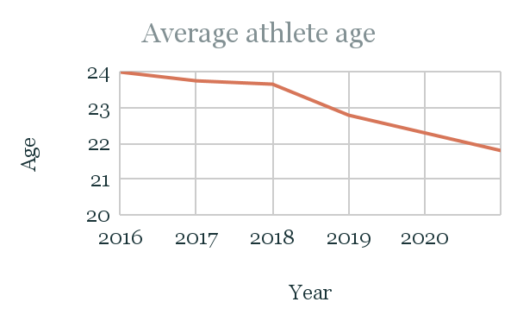
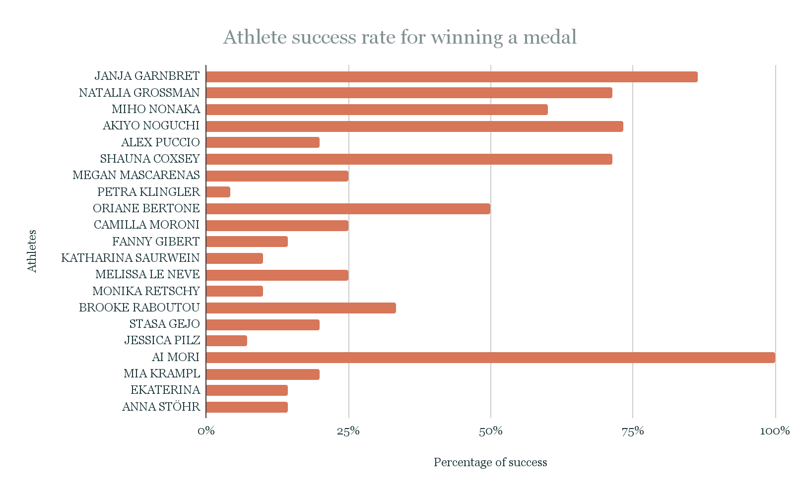

Athlete Statistics
Average height
165

Slide 6
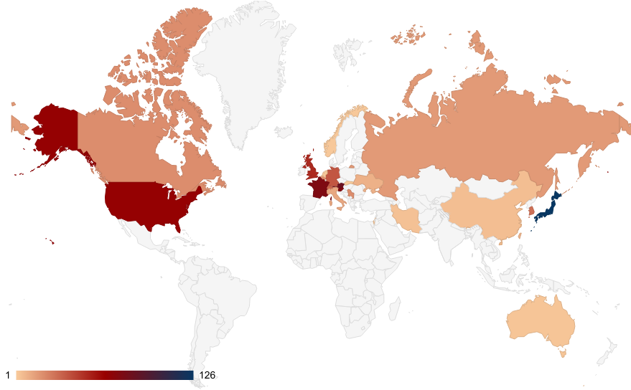
Athletes by country

Slide 7
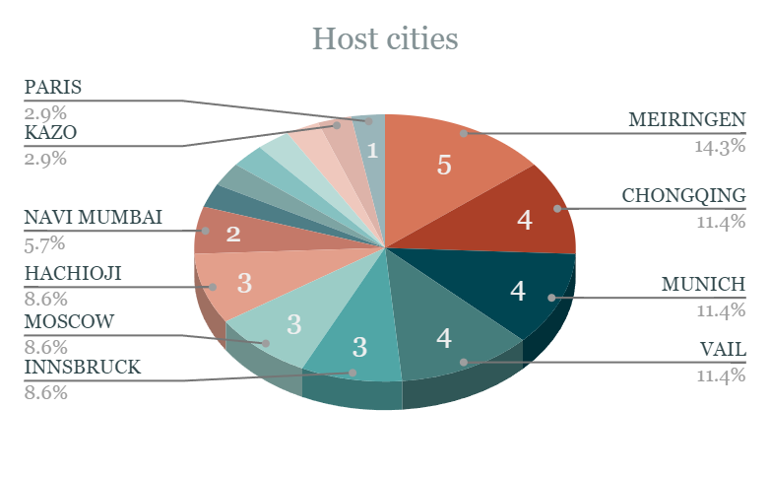
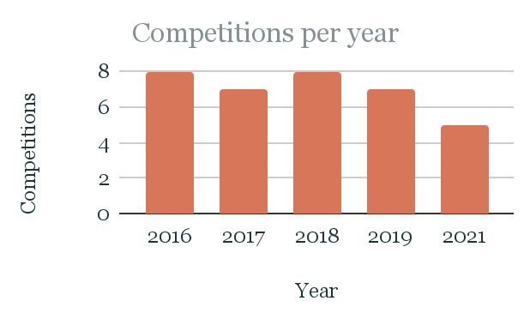
Competition Statistics

Slide 8
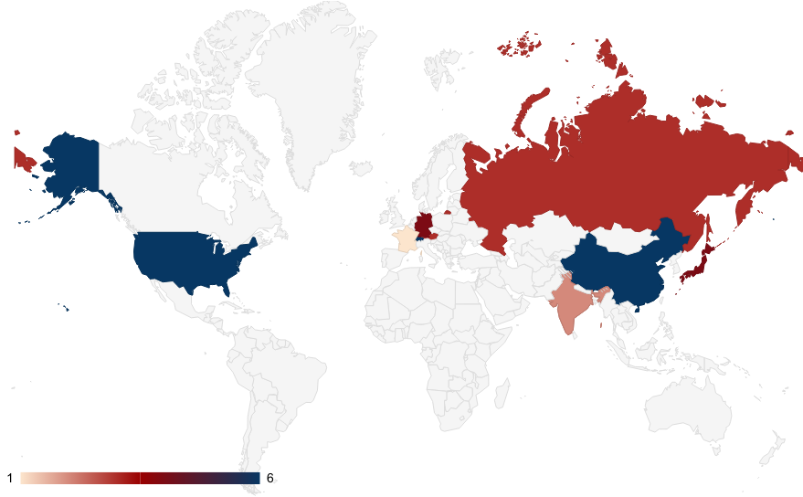
Competition locations

Slide 9
Medal Statistics
GOLD
SILVER
BRONZE
Average age: | 23 y.o.
Average height: | 164 cm
Average age: | 24 y.o.
Average height: | 164 cm
Average age: | 24 y.o.
Average height: | 166 cm
Janja Garnbret | 15
Shauna Coxsey | 8
Natalia Grossman | 3
Miho Nonaka | 3
Akiyo Noguchi | 3
Alex Puccio | 1
Megan Mascarenas | 1
Petra Klingler | 1
Akiyo Noguchi | 9
Miho Nonaka | 8
Shauna Coxsey | 5
Janja Garnbret | 4
Melissa Le Neve | 2
Oriane Bertone | 2
Natalia Grossman | 1
Camilla Moroni | 1
Fanny Gibert | 1
Katharina Saurwein | 1
Monika Retschy | 1
Akiyo Noguchi | 10
Miho Nonaka | 7
Stasa Gejo | 4
Fanny Gibert | 3
Brooke Raboutou | 2
Shauna Coxsey | 2
Natalia Grossman | 1
Jessica Pilz | 1
Ai Mori | 1
Mia Krampl | 1
Ekaterina Kipriianova | 1
Megan Mascarenas | 1
Anna Stöhr | 1
In 2019 there was one athlete that won all the World Cups:
Janja Garnbret

Slide 10
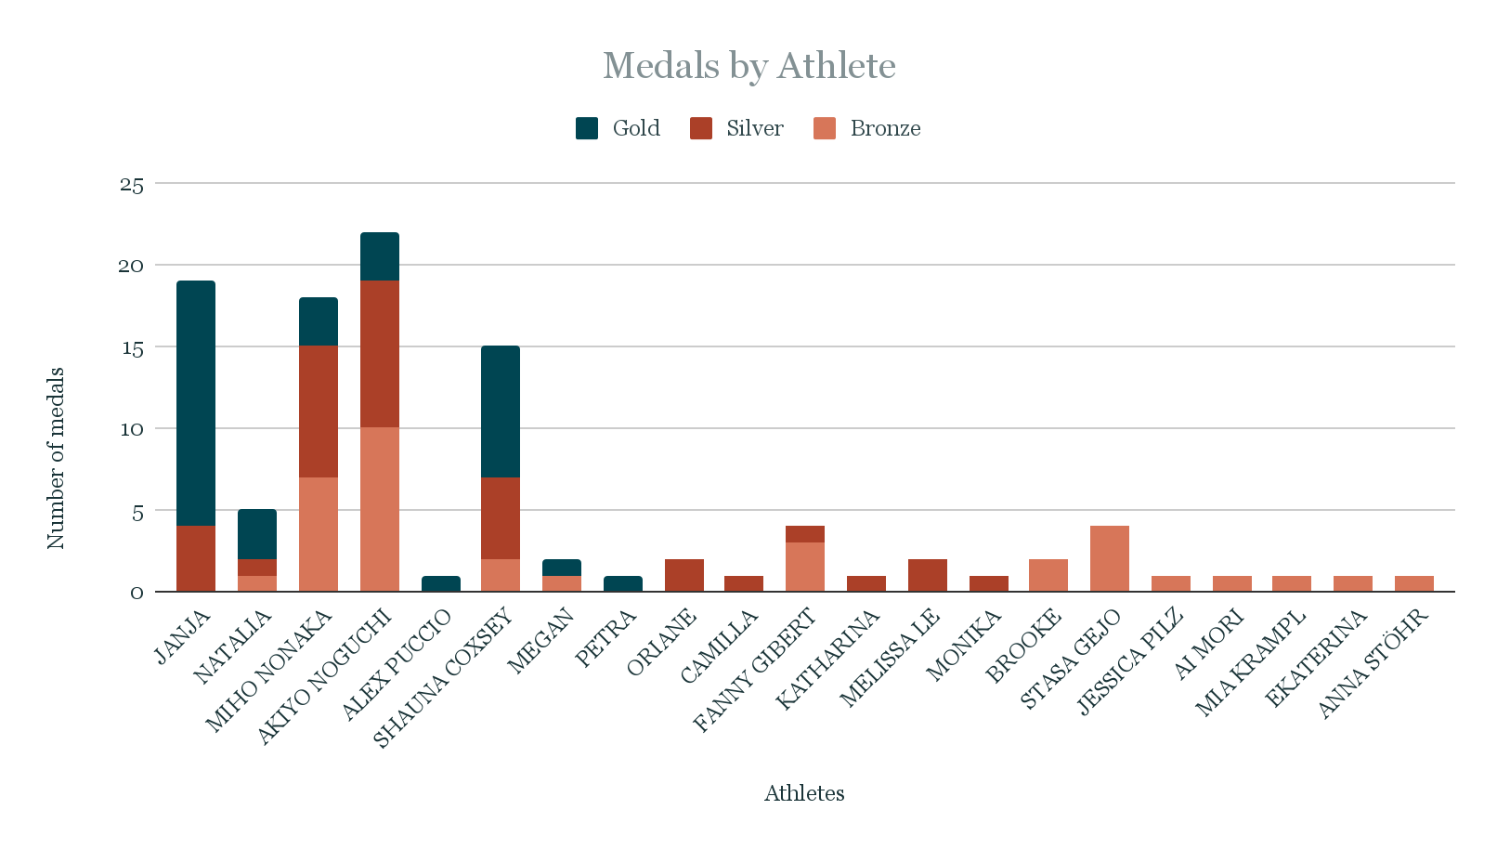
Medal Statistics - Athlete

Slide 11
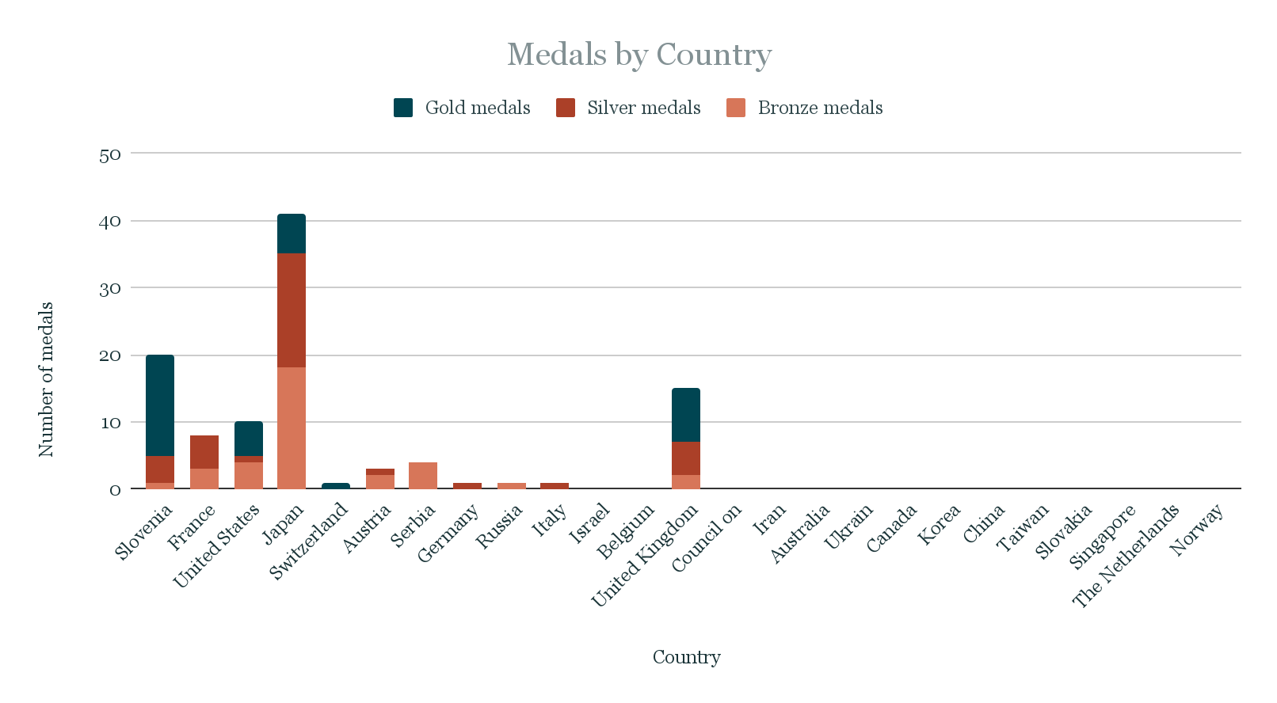
Medal Statistics - Country

Slide 12
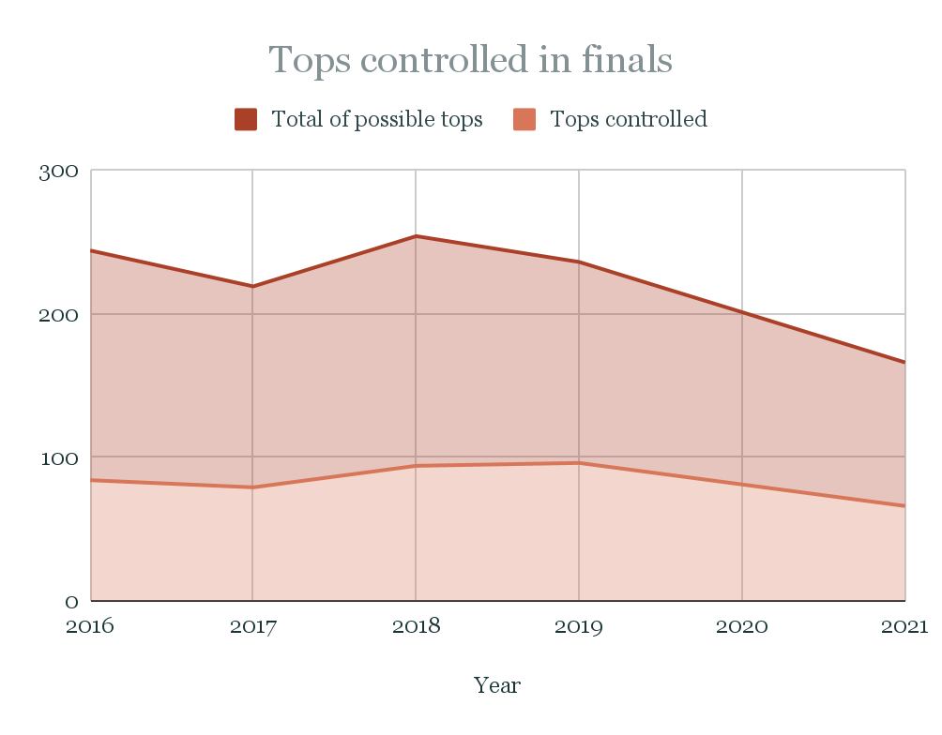
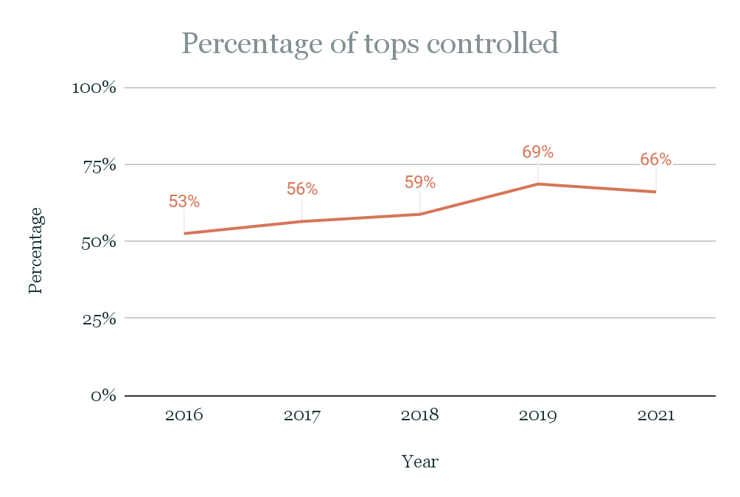
Route Statistics

Slide 13
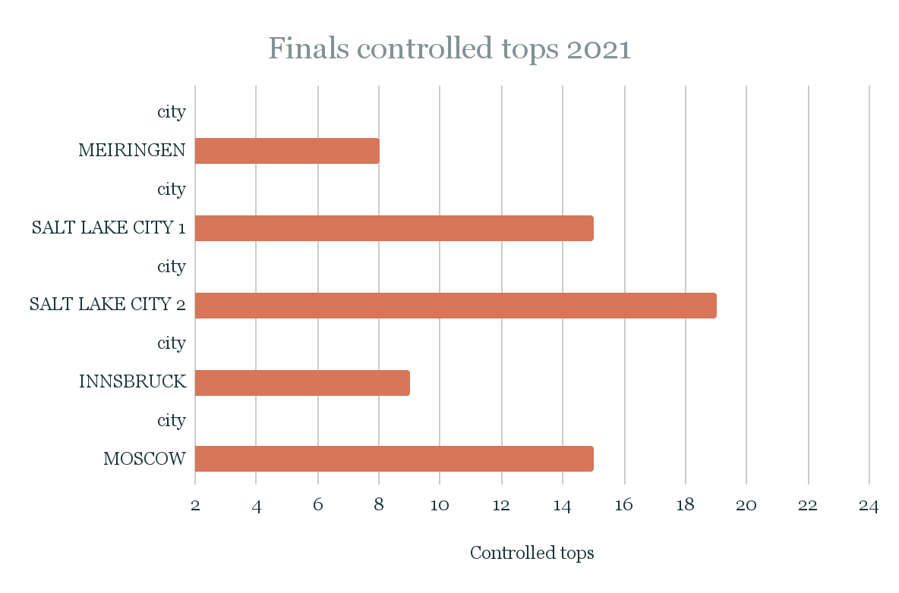
Route Statistics by year
Hardest: Meiringen (8 out of 24)
Easiest: Salt Lake City 2 (19 out of 24)

Slide 14
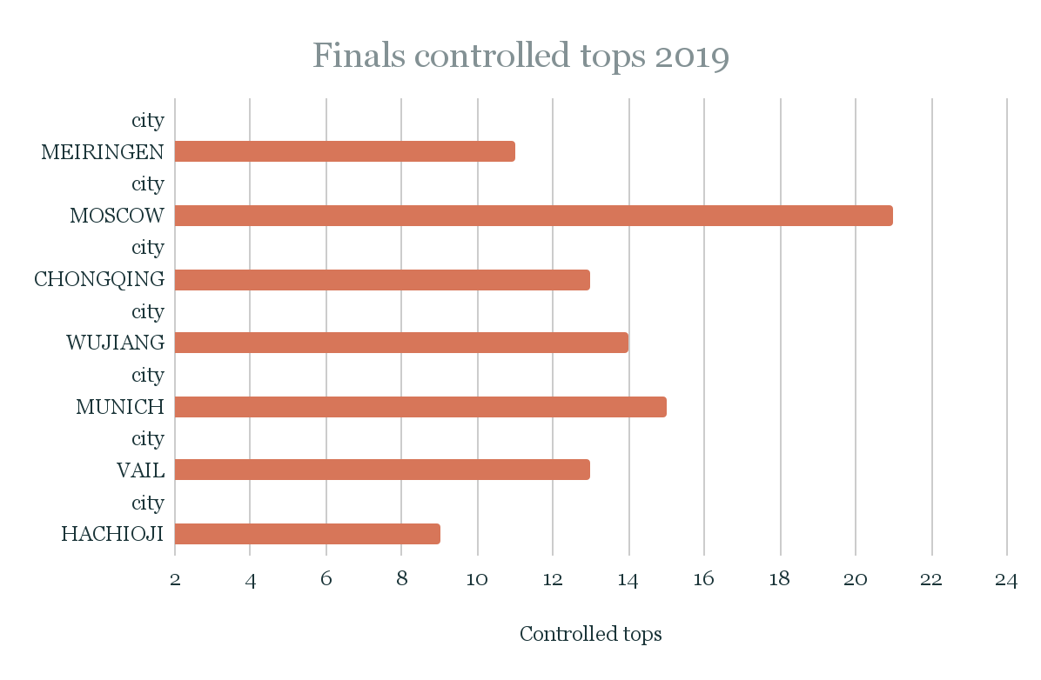
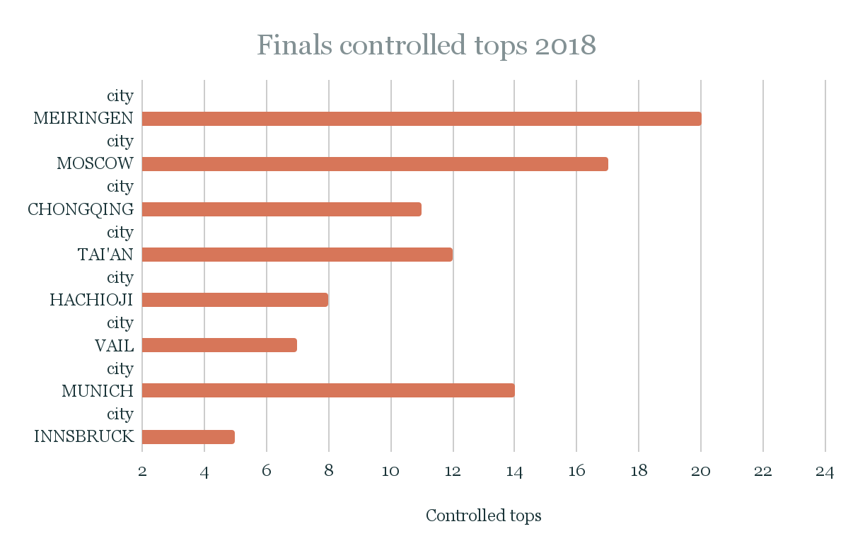
Route Statistics by year
Hardest: Hachioji (9 out of 24)
Easiest: Moscow (21 out of 24)
Hardest: Innsbruck (5 out of 24)
Easiest: Meiringen (20 out of 24)

Slide 15
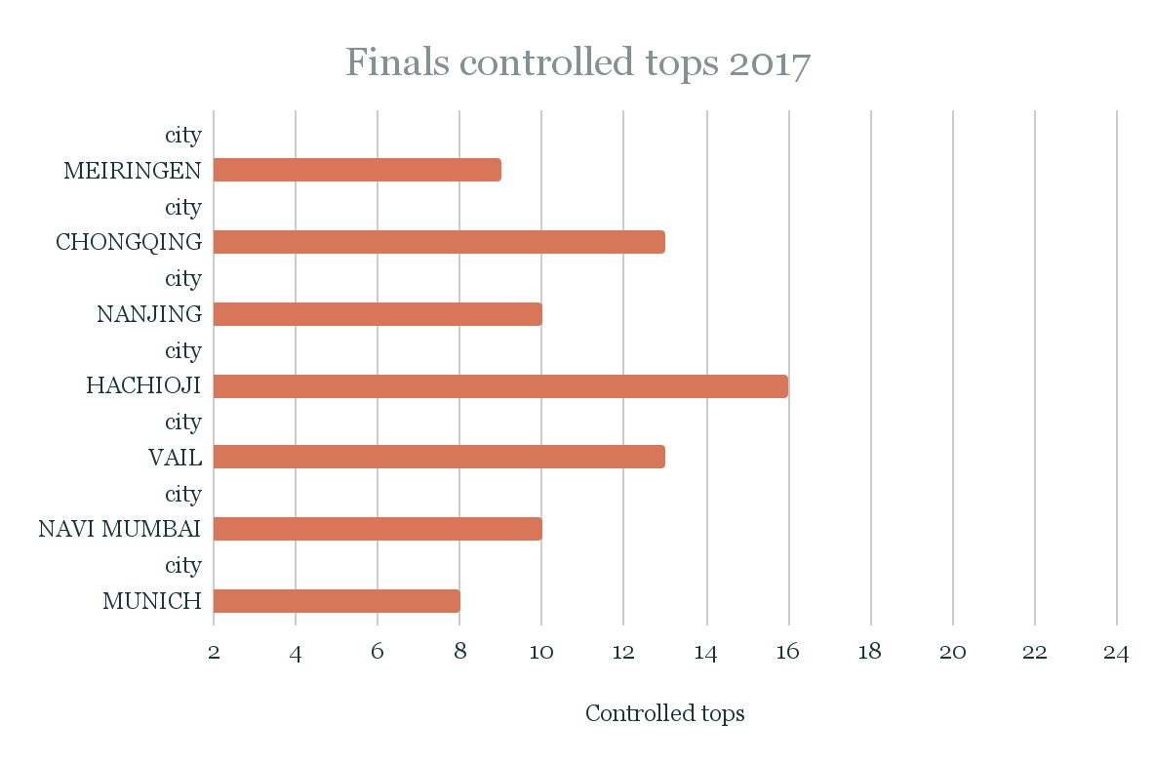
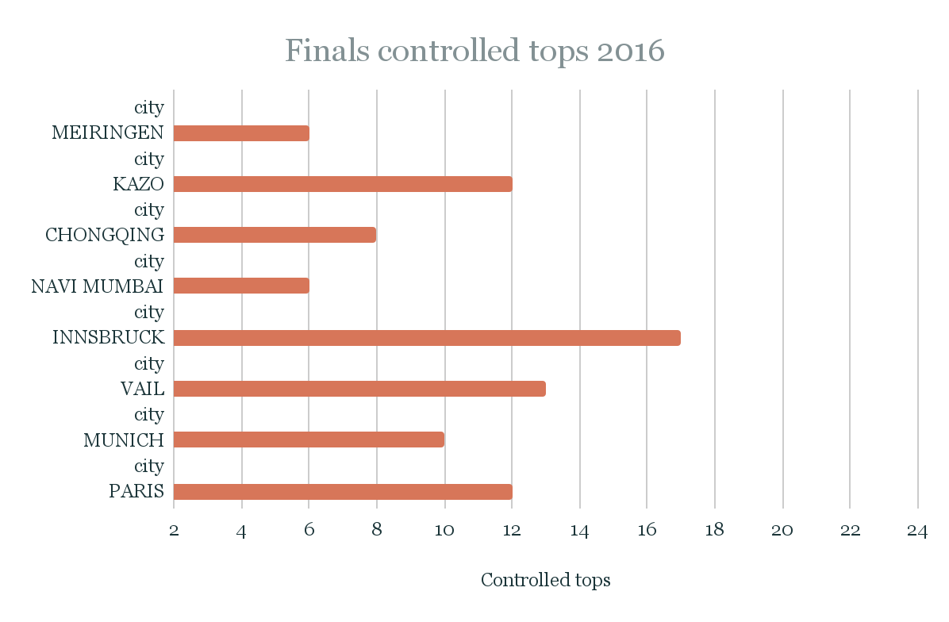
Route Statistics by year
Hardest: Munich (8 out of 24)
Easiest: Hachioji (16 out of 24)
Hardest: Meiringen & Navi Mumbai (8 out of 24)
Easiest: Innsbruck (17 out of 24)

Slide 16
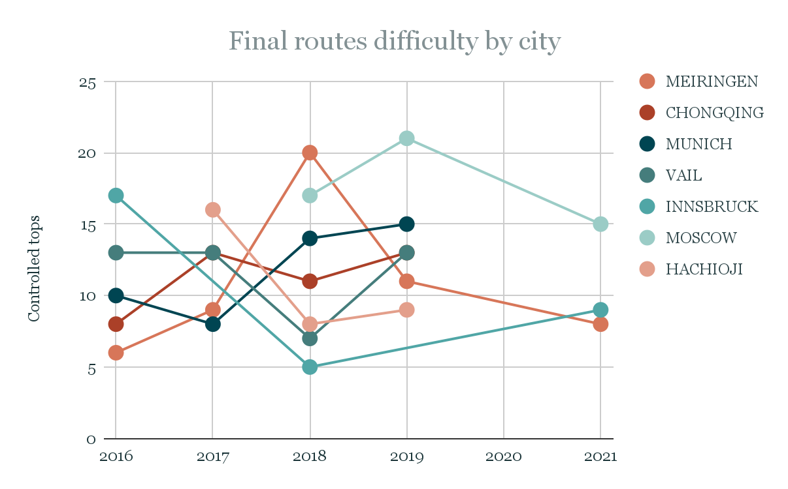
Route Statistics by city

Slide 17
Conclusion
To recapitulate | this case study objective consisted on exhibiting my analytical skills on gathering, cleaning, manipulating, analysing and visualizing data using spreadsheets and a presentation.
Skills used | clean, organize, calculate, graph, and analyze data using spreadsheet tools and, mainly, formulas. Besides presentation tools and expertise.
Future (next) steps | use pivot tables and create an interactive dashboard on excel (I chose to focus on tools and formulas on this project since my portfolio includes a case study executed on SQL and Tableau, therefore using a superior tool for creating a dashboard); analyse differences on performance from qualification rounds to semi finals to finals; include and compare data from the Men’s Bouldering World Cups;
DISCLAIMER: The slides were made for the purpose of showing a visual representation of the main insights found and presented, the complete analysis can be found in the project spreadsheet.

Slide 18
THANK YOU

